Slide 1

Leaders & Heroes
People who made a difference
Lesson #8 – Canadian Leaders & Heroes

Slide 2



Slide 3
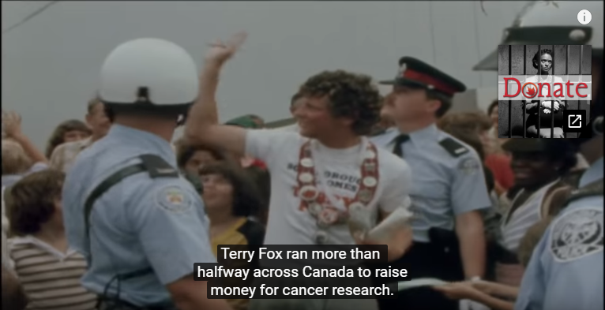

Slide 4
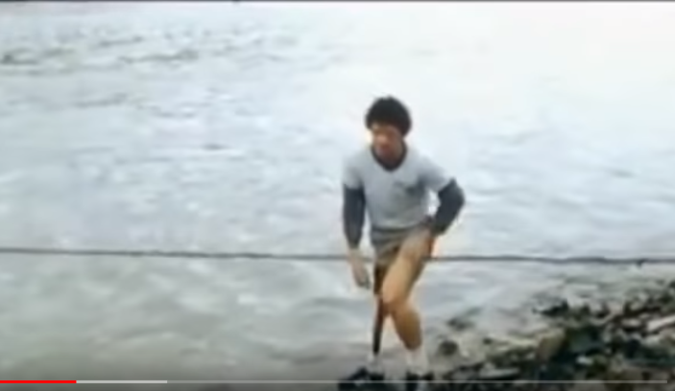
Where it all started

Slide 5
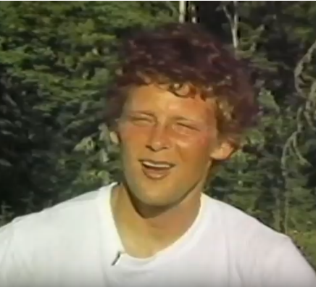
Terry Fox
In His Own Words

Slide 6
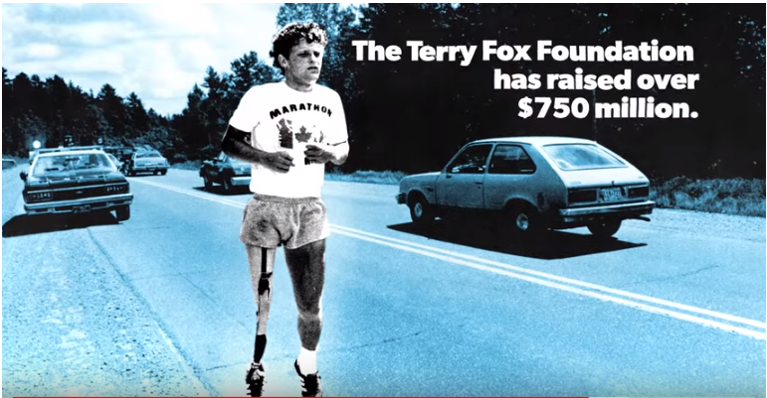

Slide 7
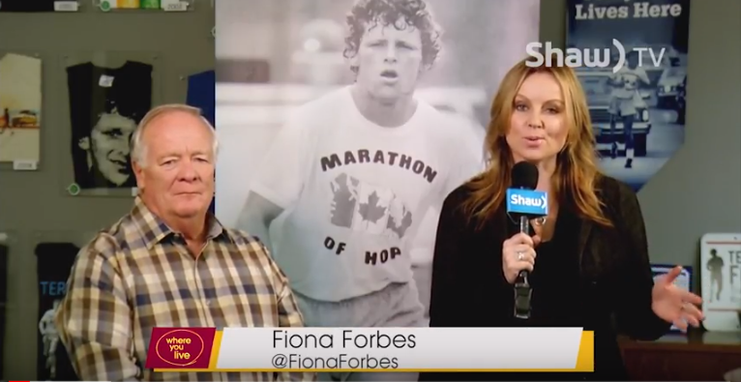

Slide 8
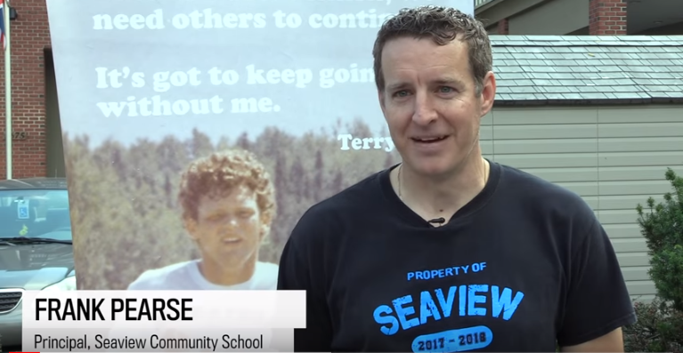

Slide 9
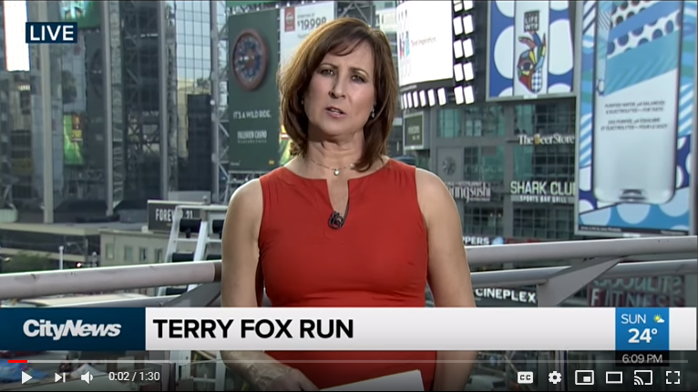

Slide 10
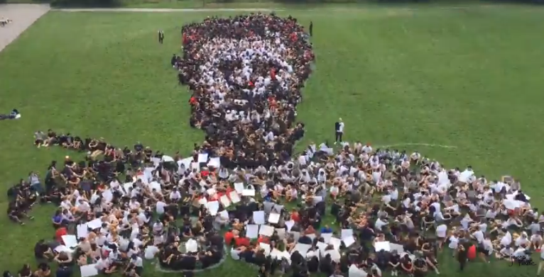

Slide 11
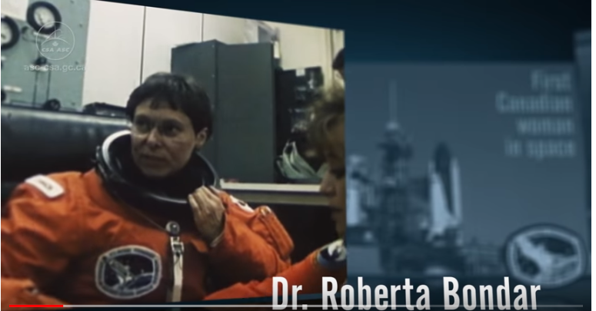

Slide 12
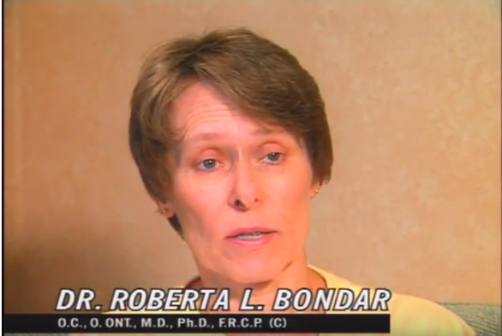
Why Be An Astronaut?

Slide 13
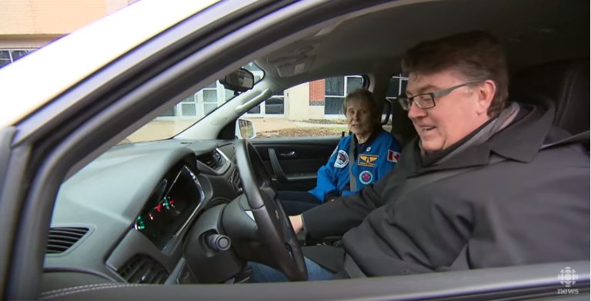
Dr. Bondar on Photography

Slide 14
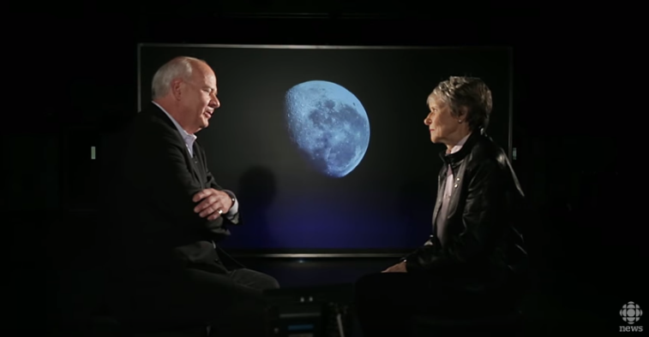
Who are you Dr. Roberta Bondar? – In conversation

Slide 15
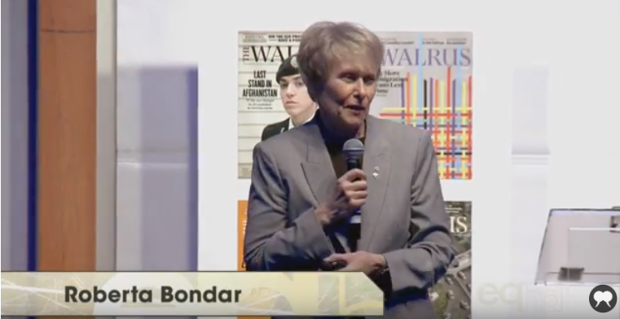
On Art at the AGO

Slide 16
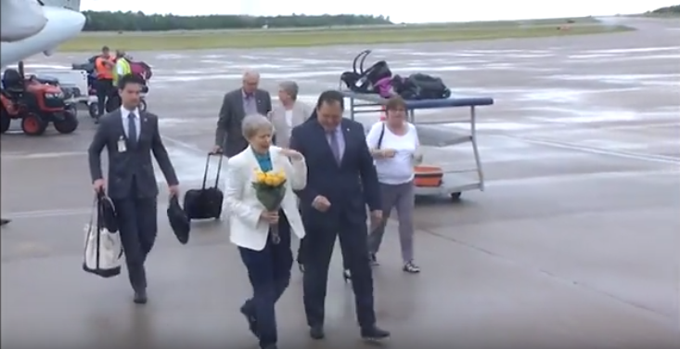
Canada 150 Honors

Slide 17
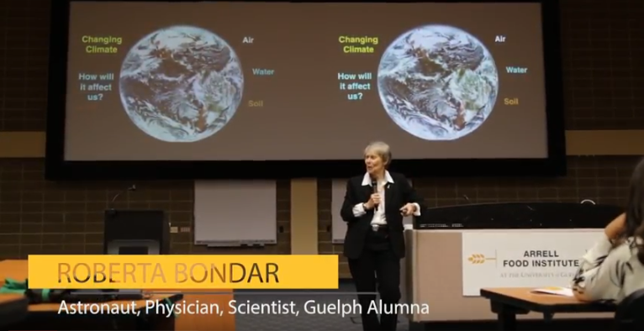

Slide 18


